Slide 1




WELCOME
APPLICANT’S BRIEFING
Moapa Band of Paiutes Flooding September 8, 2014

Slide 2
FEMA-4202-DR-NV
Declaration Date
November 5, 2014
Incident Period
September 7-9, 2014
http://www.kpho.com/story/26489464/cell-phone-video-shows-van-swept-away-in-moapa-flood

Slide 3
Flash Flooding Nevada Mission # 09092014-058 Incident Period
September 7-9, 2014
Damage Must Have Occurred During the Incident Period

Slide 4
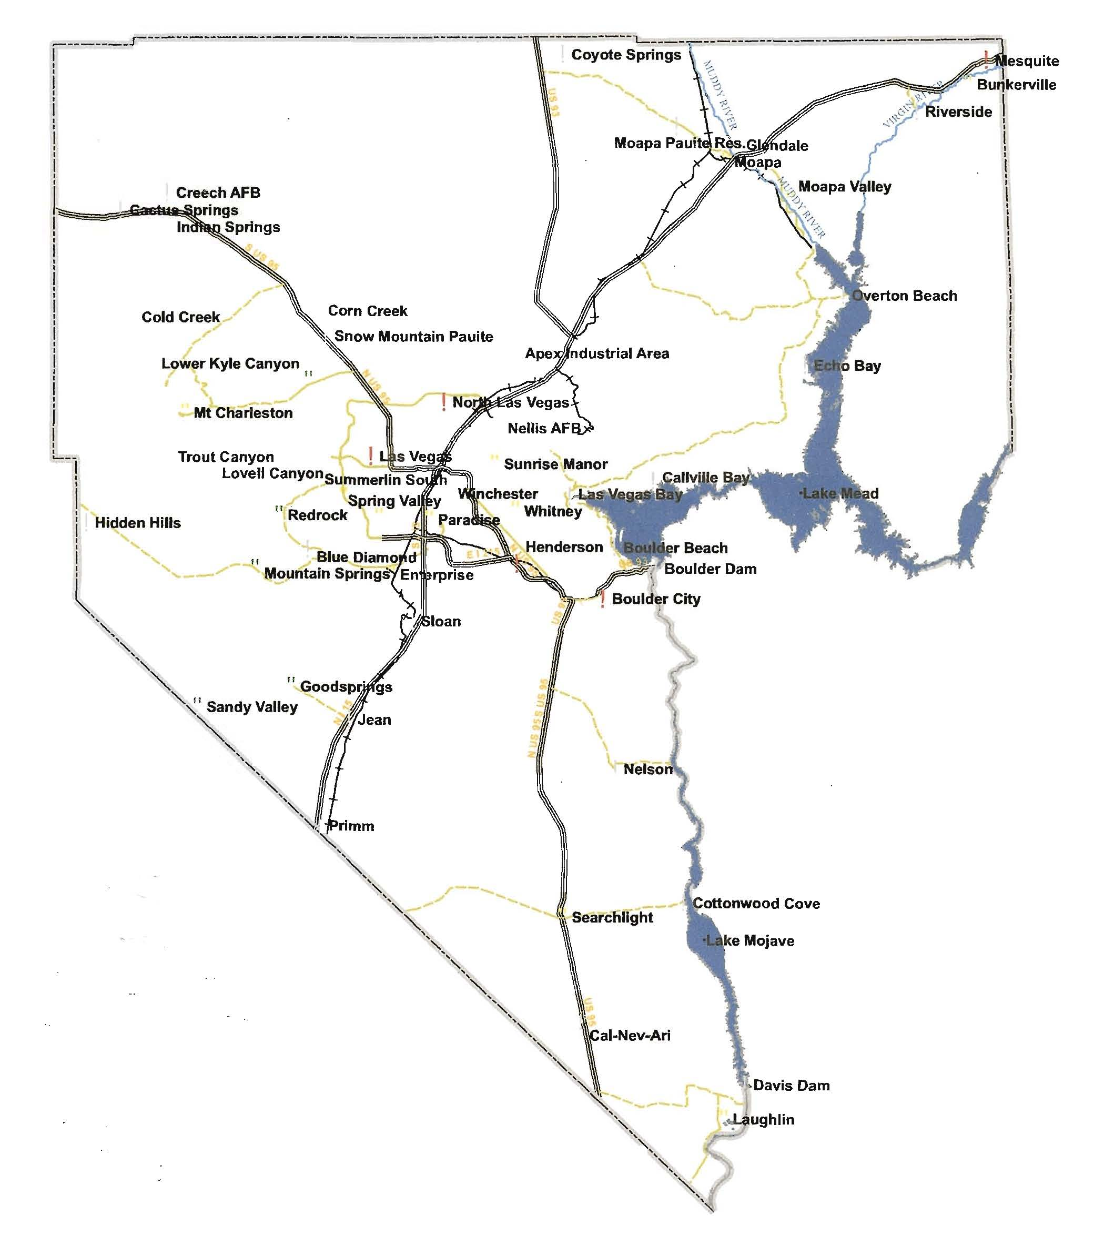
Declared Moapa Band of Paiutes

Slide 5
KEY PARTNERS
Mark Landry
FEMA Federal Coordinating Officer
Chris Smith
State Coordinating Officer NDEM Chief
Aletha Tom
Moapa Band of Paiutes Chairwoman

Slide 6
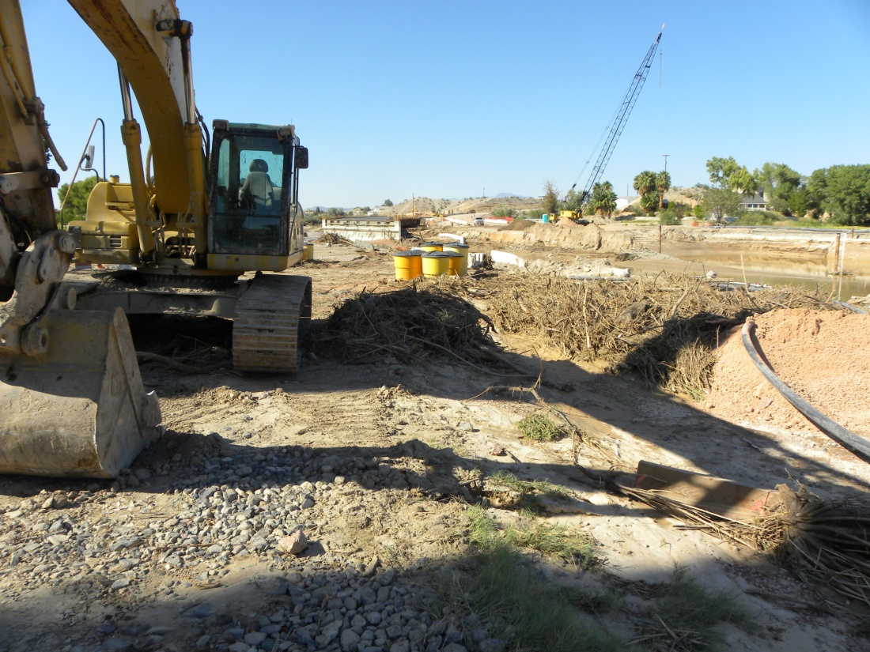
What is Public Assistance?
Supplemental financial assistance to State, Local Governments, Tribal Governments and certain non-profit organizations for response and recovery activities required as a result of a disaster
Notes:
This briefing is designed to present an overview of the Public Assistance Program. The Public Assistance Program is authorized by the Robert T. Stafford Disaster Relief and Emergency Assistance Act, Public Law 93-288 as amended. It provides supplemental financial assistance to State, local governments, and certain private non-profit organizations for response and recovery activities required as a result of a Presidentially declared disaster or emergency.

Slide 7
The Public Assistance Process
Disaster
Event
State
Tribal Declaration, PDA
Funding
Applicant
State Declaration
Request
Federal Declaration
Applicant's
Completing
Briefing
Project
Worksheets
Kickoff
PW's
Meeting
Notes:
This slide outlines the multi-step funding process under the Public Assistance Program. The disaster event triggers the declaration process which for some applicants may or may not include a Preliminary Damage Assessment (PDA). All potential applicants will attend an Applicant’s Briefing. Applicants will submit the Request for Public Assistance which is available at the applicant’s briefing and through electronic means such as the Internet, to officially apply for funding. Each Applicant will be assigned to a Public Assistance Coordinator (PAC) and the PAC will hold a Kickoff Meeting with the applicant to begin the process of documenting disaster recovery projects. The PAC will assist the applicant in completing Project Worksheets for all projects. Project Worksheets will be approved after validation. The funding will be made available to the State. The State then disburses the funding to the applicant according to State regulations.
FEMA’s goal is to provide the funding as efficiently and expeditiously as possible to allow a quick recovery of communities affected by disaster or emergency events.

Slide 8
Eligibility
COST
WORK
FACILITY
APPLICANT

Slide 9
Types of Eligible Applicant’s
State Agencies
Local Governments (County/City/Municipalities/Townships)
Native American Tribes or Tribal Organizations
Certain Private Nonprofit Organizations (PNP’s)

Slide 10
Types of Eligible Applicant’s
Private Nonprofit Organizations (PNP’s)
Critical Function
Fire/Emergency - Rescue
Emergency Medical Care
Utilities
Education
Communications

Slide 11
Private Non-Profit Entities
Non-Critical Examples
Senior Citizen Day Centers
Daycare Centers
Homeless Shelters
Shelter workshops
Libraries
Rehabilitation Facilities
Community Centers

Slide 12
Private Non-Profit Requirements
Completed RPA Package
DUNS Number
By-Laws
Tax Exempt Letter, 501(c), (d), or (e) IRS designation
PNP’s go through an eligibility evaluation. This evaluation can not be conducted until all of the above is submitted.

Slide 13
Eligibility
COST
WORK
FACILITY
APPLICANT

Slide 14
Facility Eligibility Requirements
Damage- result of the event
Located within the area declared
Legal responsibility of eligible Applicant
In active use at the time of the disaster
Not under authority of another federal agency (ex. US Army Corp. of Engineer Water Treatment Facilities, FHWA roads, etc.)

Slide 15
Deadlines for Submission
Request for Public Assistance
days after declaration for submission
= December 4th
30
List of Projects – Identified Within
days of Kickoff Meeting
60

Slide 16
Deadlines for Completion
From the date of the declaration:
November 5, 2014
Emergency work - 6 months
(+ 6 months by NDEM)
Permanent work - 18 months
(+ 30 months by NDEM)
Further extensions require
approval by FEMA

Slide 17
Eligibility
COST
WORK
FACILITY
APPLICANT

Slide 18
Types of Eligible Work
Emergency Work (Cat. A&B)
Permanent Work
(Cat. C-G)
Notes:
All projects fall into one of two types of work:
Emergency work, includes debris removal and emergency protective measures. Eligible emergency work must eliminate or reduce immediate threats to life, health, safety or improved property.
Permanent work, includes permanent repair or restoration of eligible facilities. Examples of permanent work include roads, bridges, water control facilities, buildings, utility systems, and parks.
Again work must be required as a result of the declared disaster event and be located within an area designated by the President.

Slide 19
Emergency Work
Category A - (Debris Removal)
Clearance, removal, storage, disposal
Category B - (Emergency Protective Measures)
Access, protection, emergency services, eliminate hazards, support, highways and community needs
Must be completed within SIX months of declaration – November 5, 2014
Deadline: May 4, 2015

Slide 20
FEMA
Debris Alternative Procedures Pilot Program *Sliding Scale *Recycling *Straight time *Extra 2%-Accepted Debris Management Plan

Slide 21
Permanent Work
Category C Roads and Bridges
Category D Water Control Facilities
Category E Buildings and Equipment
Category F Utilities
Category G Parks, Recreational Facilities, and other
Must be completed within 18 months of declaration – November 5, 2014
Deadline:
May 4, 2016

Slide 22
Alternative Procedures Permanent Work Pilot Program
Grants Based on Fixed Estimates
Acceptance of Sub-grantee Cost Estimates
Referral of Cost Estimates to Expert Panel
Consolidated Sub-grants
Elimination of Alternate Project Penalty
Use of Excess Funds

Slide 23
FEMA FUNDING
Cost Sharing
-75% Federal
-25% Applicant

Slide 24
Minimum Project amount fema will fund
Minimum: $3,040
Updated Annually

Slide 25
Small or Large Project
SMALL
LARGE
$121,600
Annually updated, $121,600
is the FY 15 threshold amount

Slide 26
Small Projects
Project Worksheet
Approved
Federal cost share for a small project is paid upon actual costs, inspection and completion of the project
Notes:
The applicant may prepare Project Worksheets for small projects if they have the resources to do so. Otherwise the Public Assistance Coordinator (PAC) and/or Project Officers assigned by the PAC will assist applicants in preparing Project worksheets.
FEMA or the State will validate 20% of all small projects prepared by an applicant to insure correct eligibility and reasonable costs. If the projects meet the validation criteria, FEMA will approve all small projects for funding. If they do not, another sample of projects will be validated. Funds for small projects can be disbursed by the State following project approval.

Slide 27
Large Projects
Initial payment is based on percent completed and actual expenses.
Final payment - will be based upon actual documented approved costs and project completion.
Quarterly Report Requirement – Update of work completed due to NDEM every quarter for the life of the project.
Notes:
A Project Officer will work with the State and applicant to develop the scope of work and cost estimate for all large projects. After FEMA approves large projects the State will disburse funds to the applicant as work is accomplished. Final assistance will be based on the actual costs to complete the approved scope of work. The state will make payments to the applicant according to applicable state and local laws and regulations.

Slide 28
Improved Projects
An improved project is any project where the applicant chooses to make additional improvements to the facility while making disaster repairs. The applicant is financially responsible for the additional work. Funding is capped at the original project estimate.
Must be identified to the State and approved by FEMA in ADVANCE of starting work
SCHOOL
SCHOOL
Before
After
Notes:
The applicant may decide to perform work above and beyond that which is necessary to restore a damaged facility to its pre-disaster design, capacity and function. This is called an improved project. The State must approve the project and FEMA must ensure that its environmental and historic compliance responsibilities are met prior to project approval.
The grant money for the original disaster-related damage repairs can be applied towards the costs for the improved project. Your Public Assistance Coordinator can discuss these details further.
<<State input on how the state share will be calculated.>>

Slide 29
Alternate Projects
Funds used for a project other than repair of the damaged structure:
90% of approved federal cost share for government entities
75% of Approved federal cost share for PNP entities
Facility abandoned – must be rendered secure
Must receive FEMA prior approval
Cannot have 406 (PA) mitigation funding
All parts of the project will be reviewed for Special Considerations
DAMAGED
SCHOOL
Funding
New
Location
SCH
OO
L
Notes:
The applicant may decide that the community would best be served by not restoring a damaged facility or the function of that facility. As this slide depicts, the applicant decided that the disaster damaged building is no longer needed and the money could best be used by expanding another building.
This option, which is only available for permanent work, must be requested formally in writing prior to alternate project approval. It is not an option for emergency work or debris removal projects. Alternate projects must be reviewed to assure environmental and historical compliance.
FEMA funding will be 90 percent of the federal share of the approved federal estimate for the original eligible project without any added mitigation measures. Your Public Assistance Coordinator can discuss these details further.
<<State input on how the state share will be calculated.>>

Slide 30
Special Considerations
Environmental Requirements
Hazard Mitigation
Historic Preservation &
Cultural Resources
Special Flood Hazard Areas
Insurance Requirements
Notes:
FEMA uses the phrase “Special Considerations” to cover regulatory and policy compliance issues related to:
Hazard Mitigation
Floodplains or Coastal High Hazard Areas, which are also known as Special Flood Hazard Areas.
Environmental Requirements. These include, but are not limited to, the National Environmental Policy Act, the Endangered Species Act and the Coastal Barrier Resources Act.
Historic Preservation and Cultural Resources
Insurance
The applicant is responsible for ensuring that all special consideration issues are addressed prior to project approval. FEMA and the state have assembled a resource pool that can assist the applicant in all of the various special consideration areas. Failure to identify and resolve special consideration issues early in the recovery process has resulted in protracted delays in providing assistance to applicants. FEMA’s goal is to provide disaster assistance in a timely manner. Throughout the recovery process FEMA staff will ask questions to identify and resolve special considerations issues.
The next section of this briefing will address the various special considerations in more detail.

Slide 31


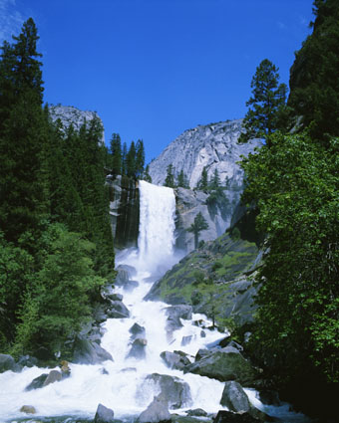




Environmental Requirements
Ensure that all practical means
are used to protect,
restore, and enhance
the environment
Notes:
The project officers will provide guidance on environmental laws tide to funding.

Slide 32

Historic Preservation
Property eligible for listing on the National Register of Historic Places requires special consideration under the National Historic Preservation Act
Notes:
Property eligible for listing on the National Register of Historic Places requires special consideration, these properties are generally 50 years old or older. The applicant will assist the Public Assistance Coordinator in identifying these historic resources. Keep in mind that they can include buildings, bridges, roads, Native American cultural heritage sites, and archeological sites.
The State Historic Preservation Officers are key to assisting FEMA in fulfilling its historic responsibilities defined in the National Historic Preservation Act.

Slide 33
Special Considerations
Historic Preservation
Listing on the National/State Register of Historic Places
Buildings, landscapes, archaeological sites, or even bridges and water treatment plants
Not necessarily old but important to local, state, or national history
Requires special consideration under the National Historic Preservation Act

Slide 34
Hazard mitigation 406
Cost effective measures that reduce the potential for damages to a facility from a future event
Optional & 25% Cost Share
Only Permanent Work is eligible for Hazard Mitigation 406
Notes:
Property eligible for listing on the National Register of Historic Places requires special consideration, these properties are generally 50 years old or older. The applicant will assist the Public Assistance Coordinator in identifying these historic resources. Keep in mind that they can include buildings, bridges, roads, Native American cultural heritage sites, and archeological sites.
The State Historic Preservation Officers are key to assisting FEMA in fulfilling its historic responsibilities defined in the National Historic Preservation Act.

Slide 35
Hazard Mitigation Scenario
Pre-disaster
Disaster damage
Larger culvert with
concrete wing-walls
Section
Section
404
406
New upstream
retention pond

Slide 36
HMGP Funding – Section 404
Overview
Post Disaster Program
20% (15% + 5% enhanced state) of total estimated Federal public assistance for a disaster
Administered by the State
Cost share 75/25
Competitive Grant program will be offered to Moapa Band of Paiutes, then County, then State.

Slide 37
STATE CAN CHOOSE TO FUND:
Up to 100 % for Mitigation Projects OR
5% set-aside projects
Projects that are considered to be sound
mitigation projects but outside the usual
criteria, i.e., public education, electronic reader boards, etc.
7% for Mitigation Plan Development

Slide 38
HMGP Planning Requirement
404 Funding requires an adopted Hazard Mitigation Plan (44 CFR 201.7)

Slide 39
Insurance
Disaster assistance provided is intended to supplement financial assistance from other sources.
Disaster assistance will not be provided for damage or losses covered by insurance.
Insurance coverage must be subtracted from all applicable PA grants in order to avoid duplication of financial assistance.
The Applicant must obtain insurance on damaged insurable facilities (buildings, equipment, contents, and vehicles) as a condition of receiving grant funding.
If a PW is over $5,000 an insurance requirement is placed on items that can be reasonably insured for life
FEMA will cover insurance deductibles

Slide 40
Eligibility
COST
WORK
FACILITY
APPLICANT

Slide 41
COST
Reasonable and Necessary
Complies with federal, state and local laws & regulations
Insurance proceeds and purchase discounts must be deducted

Slide 42
Eligible Direct Costs Examples
Force Account Labor
Force Account Equipment
Rented Equipment
Contracting
Purchase of Materials
Materials from Inventory

Slide 43
Labor
Force Account Labor plus Fringe Benefits
Emergency Work: All OT eligible, temporary employees regular time eligible. All other time ineligible.
Permanent Work: All labor eligible
Also travel and per diem for employees performing eligible activities, in accordance with GSA rates.
Note: SRIA will cover straight time for debris removal if you signed up for this at the Kick Off meeting

Slide 44
Equipment
Perform eligible work
Auto/Truck – mileage or hourly rate
Other equipment- hourly rate
Stand-by time ineligible
Intermittent Use
Half day or more = full day
Less than half day = actual hours

Slide 45
Equipment Rates
Local rates (preferred) are used if different than FEMA and established prior to the disaster
FEMA rates are used for determining project costs (estimating & comparing)

Slide 46
RENTED EQUIPMENT
Rented equipment summary record must be complete with equipment type, dates/hours used, hourly rate, vendor, date and amount paid, and check number
Paid invoices/receipts for rental equipment

Slide 47
Contracts
All contracts incurred for eligible work are reviewed by FEMA-State teams; includes rental equipment
Competitively bid with fixed-procurement procedures in accordance with NRS, CFR, & Tribal Regulations.

Slide 48
Contracts Cont.
Lump sum contracts are acceptable:
Easy to monitor when the scope of work is well defined
Requires minimum labor for monitoring
Quantities do not have to be documented
Time and material contracts are acceptable BUT:
Should only be used for emergency “hot spots” (early debris rights-of-way clearance)
MUST have a cap and MUST be monitored
Generally accepted for first 70 hours of actual work and then need to be converted to a lump sum contract

Slide 49
Ineligible Contracts
Cost-plus percentage of cost
Contingent upon FEMA reimbursement
Contract with a debarred contractor

Slide 50
Materials
Purchased or stock
Used for eligible work
Need invoices, historical data or area vendor quotes
Material costs must be reasonable
Document actual material/supplies usage
Re-stocking inventory cost is not eligible
Proof of payment

Slide 51
Donated Resources
A credit can be applied towards the local cost share for both Volunteer Labor and Donated Equipment for Category A & B Work Only
Volunteer Labor:
Rate for volunteer labor is the same rate (plus reasonable fringe benefits) paid for similar work within applicant’s organization.
If applicant has no employees performing similar work, the rate is equal to those ordinarily performing work in the same labor market.
Value of Volunteer Labor = (Determined Labor Rate) * (Number of Volunteer Hours)
Donated Equipment:
Rate is determined by local rates (if established) or FEMA equipment rate.
Value of Donated Equipment = (Determined Equipment Rate) * (Number of Equipment Hours in Use)
Donations credit capped at non-federal share of emergency work (may apply toward certain portions of community's non-federal share of recovery costs)

Slide 52
Common Audit Findings
1. Failure to Support costs claimed
2. Claims in excess of actual costs or costs not consistent with normal practice
3. Eligibility issues
4. Failure to offset cost with insurance proceeds
5. Excessive or unreasonable charges – FEMA or local costs codes should be used
6. Improper contracting – contracting must be consistent with established policy and procedure. FEMA likes to avoid “cost plus” and “time and material” contracts.
7. Work beyond approved Scope of Work – FEMA will put it back as it was – where it was
Please use the common sense rule

Slide 53
Record Keeping
Accurate records of expenses must be maintained.
Create a separate file for each Project Worksheet (PW) containing all backup documentation required to support the cost of the project.
Your files should stand alone. An auditor should not have to ask someone to explain each document or expense. As you prepare your records, ask, “Will someone who didn’t go through the disaster understand the records?”
Maintain records for 7 years.

Slide 54

Appeals
Any determination related to Federal assistance may be appealed.
The time limit for appeal submission is 60 days from receipt of notice of the action which is being appealed.
Notes:
The subgrantee or applicant may appeal any determination previously made related to federal assistance. The appeal shall be made in writing and submitted to the grantee or State within 60 days after receipt of notice of the action which is being appealed. There are two levels of appeal, one to the Regional Director and one to FEMA Headquarters.
<<State input>>

Slide 55

Rounding third base almost home

Slide 56
Steps to Getting Assistance
Request for Public Assistance
Complete Project Worksheets
FEMA Obligates Funds – State disburses Funds to Sub-Grantee
Approval from Boards, Commissions and Councils
Notes:
There are four primary steps to obtaining disaster assistance and the next section of the briefing discusses these steps.
1. A Request for Public Assistance is submitted by the applicant.
2. A Public Assistance Coordinator, also known as the PAC, will then be assigned to each applicant. The PAC will hold a kick-off meeting with the applicant to explain the process and procedures in detail. It is very important for the applicant to ensure that personnel who are familiar with the projects attend this meeting.
3. The applicant presents a list of damages to the PAC at the kickoff meeting. This list is the basis for developing Project Worksheets which are used to obligate funds.
4. The PAC works with the applicant to develop all Project Worksheets and insure all projects are identified, eligible and complete.
5. Upon approval of the Project Worksheets, the funds are obligated to the State. The State as the grantee, will disburse Public Assistance funds to the applicant. Again Federal funds for small projects will be disbursed after approval and Federal funds for large projects will be disbursed as work is accomplished.

Slide 57
What’s Next?
Submit completed RPA & List of Projects.
Applicant meets with team at kickoff meeting - projects are scoped out in preparation for estimating
Projects are identified within 60 days of Kickoff Meeting

Slide 58
Additional Information
Your FEMA/ State Team (1st Point of Contact)
NDEM Recovery Guide
NDEM’s Website (www.dem.nv.gov)
FEMA’s Website (www.fema.gov)
FEMA Policy Digest No. 321
FEMA Public Assistance Guide No. 322
FEMA Applicant Handbook No. 323

Slide 59
REQUEST PUBLIC ASSISTANCE
PLEASE TURN IN YOUR REQUEST FOR PUBLIC ASSISTANCE
AND LIST OF PROJECTS
NOW
This allows FEMA to schedule your Kickoff meeting.

Slide 60
TIME LINE
30 days from declaration (11/05/14)
- submit RPA
60 days from kick-off (12/xx/14)
- report ALL disaster related damages
6 months from declaration (5/5/14)
- all emergency work (Categories A-B) completed
18 months from declaration (5/5/16)
- all permanent work (Categories C-G) completed

Slide 61
LAST ITEMS
Please do not leave before signing up for a Kick-off Meeting at the back table

Slide 62
CONTACT – Public Assistance
Rick Martin
NV Division of Emergency Management
775-687-0306
rmartin@dps.state.nv.us
Samuel Ronveaux
Federal Emergency Management Agency
510-368-0354
Samuel.Ronveaux@FEMA.dhs.gov
Terry Bohl
Moapa Band of Paiute Emergency Manager
775-233-6641
Terry.iterc@gmail.com
Thank you!

Slide 63
CONTACT – Hazard Mitigation Assistance
Debbie Tanaka/Karen Johnson
NV Division of Emergency Management
775-687-0314
Debbie.tanaka@dps.state.nv.us
kijohnson@dps.state.nv.us
Tom Miller
Federal Emergency Management Agency
202-805-8702
Tom.miller@FEMA.dhs.gov
Thank you!

Slide 64
CONTACT – National Flood Insurance Program
Rob Palmer
NV Division of Water Resources
775-684-2847
rkpalmer@water.nv.gov
Michael Hornick
FEMA
510-207-8013
Michael.hornick@fema.dhs.gov
Thank you!

Slide 65
CONTACT – Media
Gail Powell
NV Division of Emergency Management
775-687-0325
gpowell@dps.state.nv.us
Mary Simms
FEMA
510-301-7914
Mary.simms@fema.dhs.gov
Thank you!

Slide 66
QUESTIONS?

